Slide 1
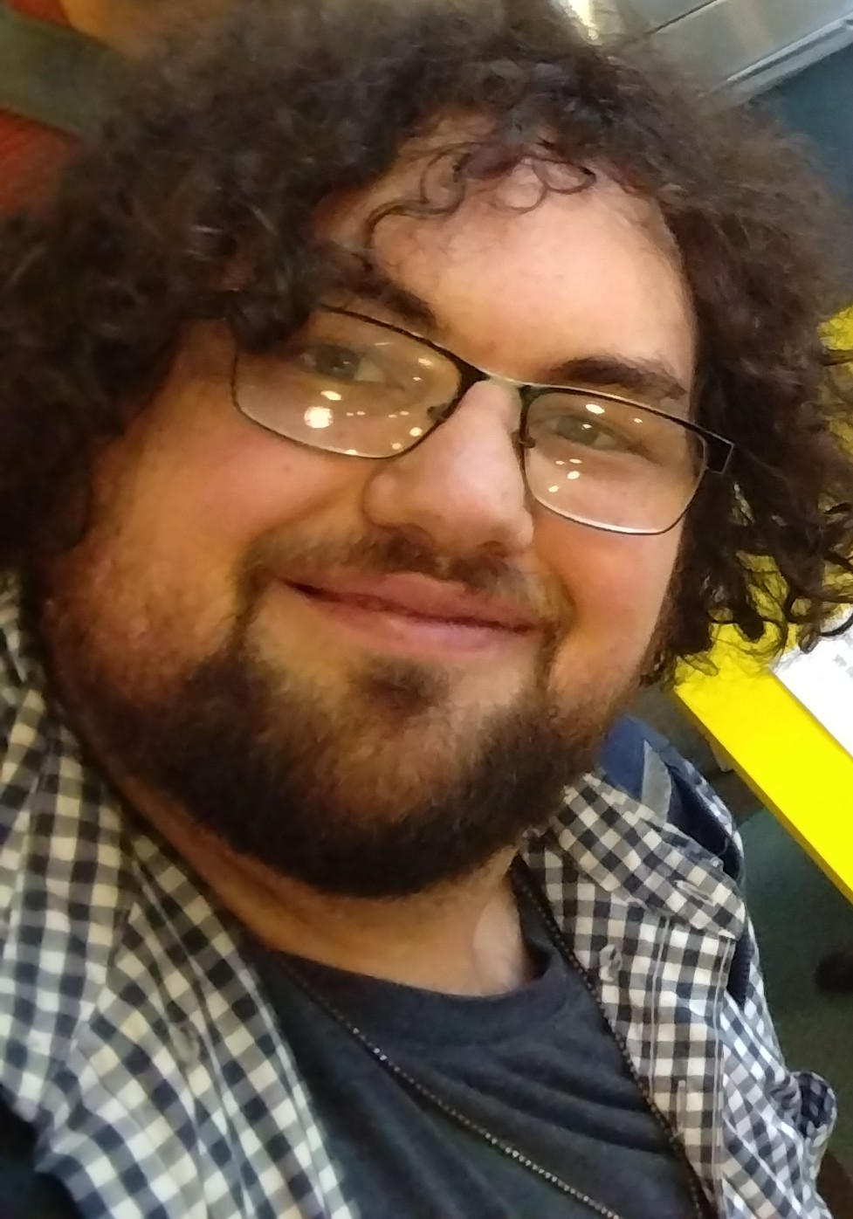
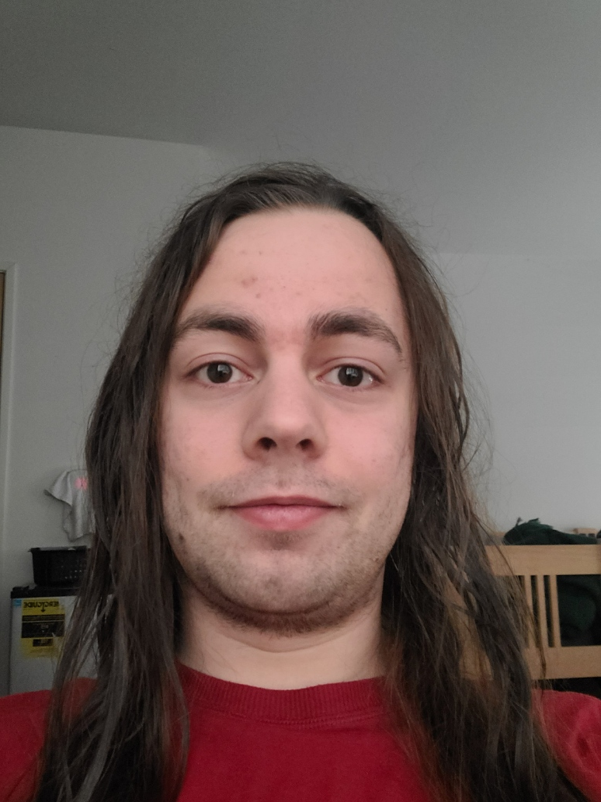
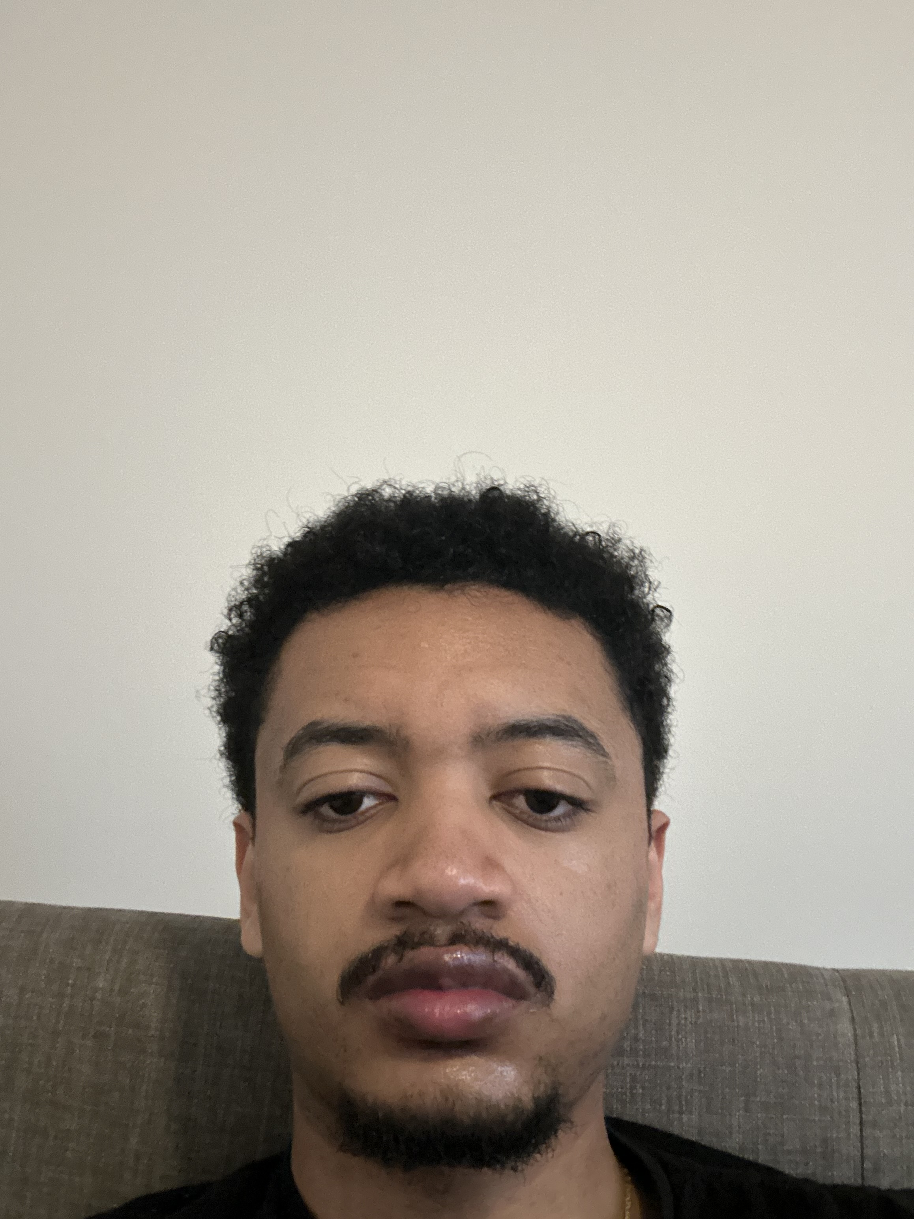
Team magenta presents: OK Results
J. Chris Marek
Nate Bartlett
Samuel
Tassew

Slide 2
Overview
OK Results is an OKR (Objectives and key results) application, designed to streamline the process of relaying information between employers and employees. With most modern apps, some information is lost when employees report their progress, whereas our app aims to minimize that information loss, while still being user-friendly.

Slide 3
Personal Overview
Our app was designed with business owners in mind, as we know the difficulty of project management scales exponentially with the number of employees. Our program aims to make this problem easier for business owners to handle, by condensing the information into a single database, and providing the tools necessary to track each employee’s progress without too much work.

Slide 4
Key MVP Features
Create: Adds a new team, employee, key result, or objective to the database. Allows for full customization of values.
List: Provides the user with all values held in a database of their choice.
Update: Allows the user to change any value in the table excluding primary keys, to avoid data mix-ups.
Delete: Removes specified entries from the database.
Help: Displays all currently implemented commands, for ease of access.
Unimplemented: Conversion of data to spreadsheet.

Slide 5
Tech Stack
Tools Used:
SQLite-The database used by the app.
SQLiteStudio-Allows us to view the data in real time.
ChatGPT-Used for debugging, and for the method that handles SQL errors.
Gemini- Used for creating the wireframe
VSCode-The IDE used to design the app.

Slide 6
Demonstration

Slide 7
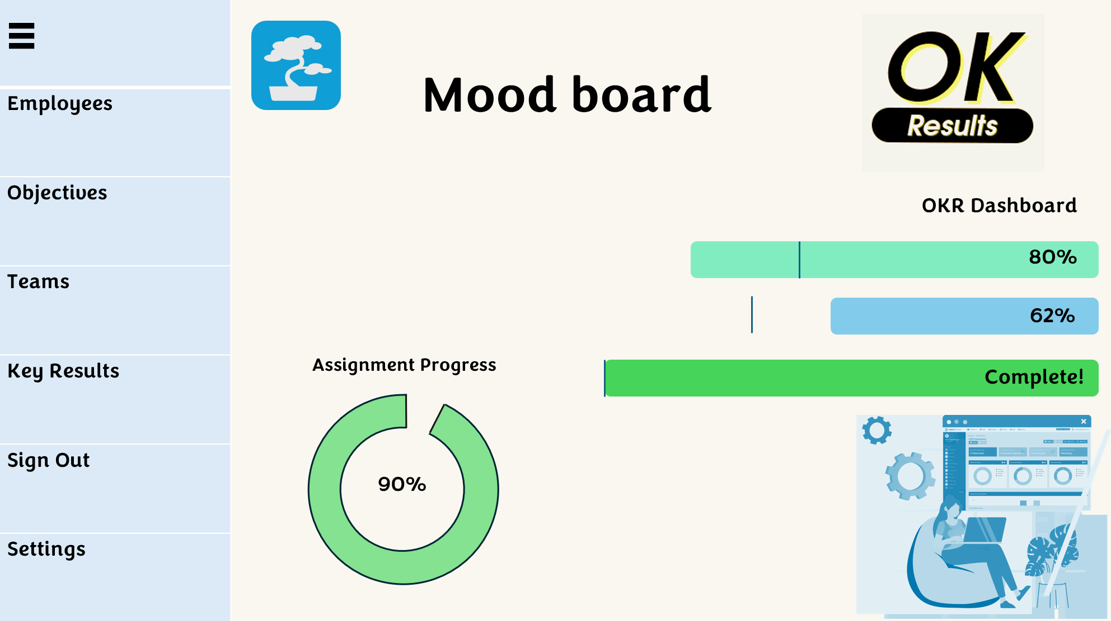
Moodboard and Wireframe

Slide 8
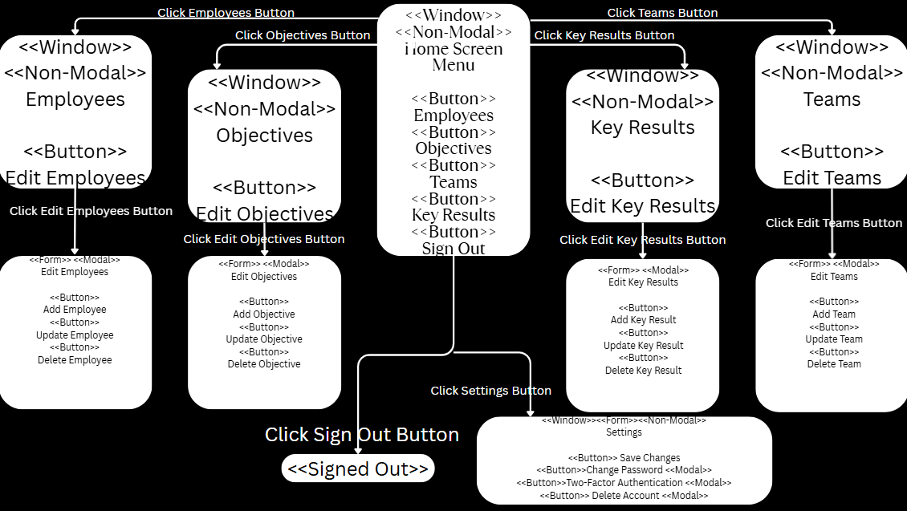

Slide 9
Team Dynamics
Over the course of the quarter, each member of our team put in a ton of work on getting our app to a functional state, as well as presenting our plans and efforts to the class.
Nate wrote the code that connected the app to the database, setting up the tables, and programmed the create and delete functions.
J. Chris wrote the code for the update and select functions. Created the navigation diagram and helped with prepping all the presentations
Samuel came up with the original concept for the app, created the wireframe, and handled most of the project presentations.
Overall, the group work went smoothly, and we were able to produce something we are all proud of. Communication between members was difficult at times but everyone did take part at least partially every step of the way.

Slide 10
Project Takeaways
T. Samuel
I learned how important the initial idea and concept development are when starting an application.
I learned how to communicate technical ideas clearly when presenting a project to others.
I learned how planning and organizing a project helps guide the development process even before coding begins.
J. Chris:
I learned how to implement and use SQL databases
I learned how to construct a framework on which an application can be built (ERD, Wireframe, etc.)
I learned that taking application design step-by-step provides a clear vision of what that application will become
Nate:
I learned that coding in a group environment makes everything a lot easier to manage.
I learned how SQL works, and how to properly implement it in future projects.
I learned the importance of mood boards, especially when applied to other mediums, like art.

Slide 11
Q&A

